Slide 1
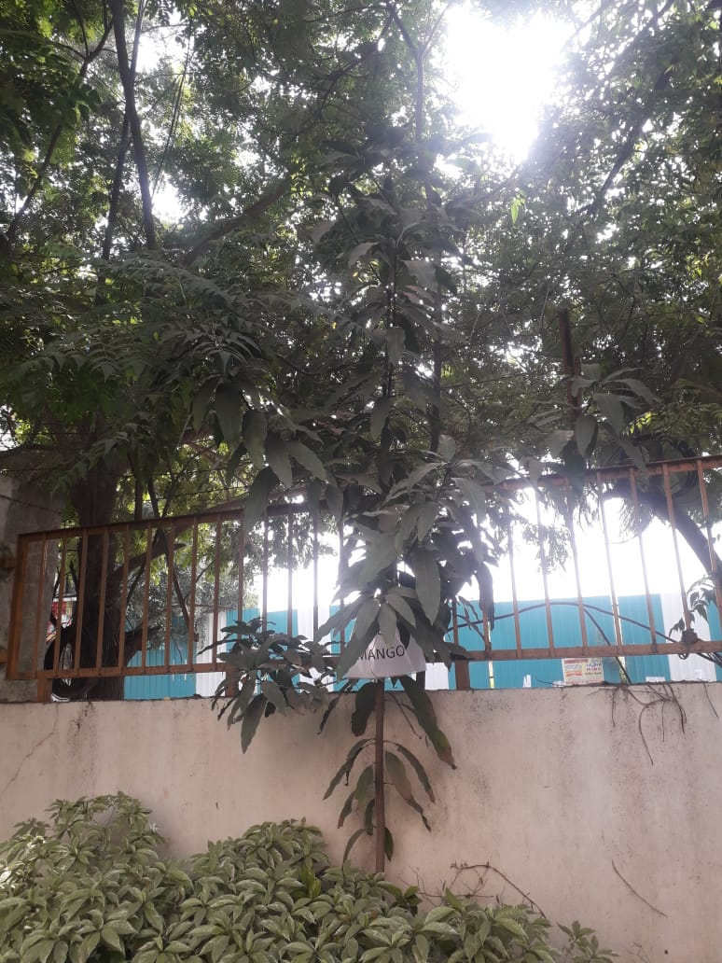
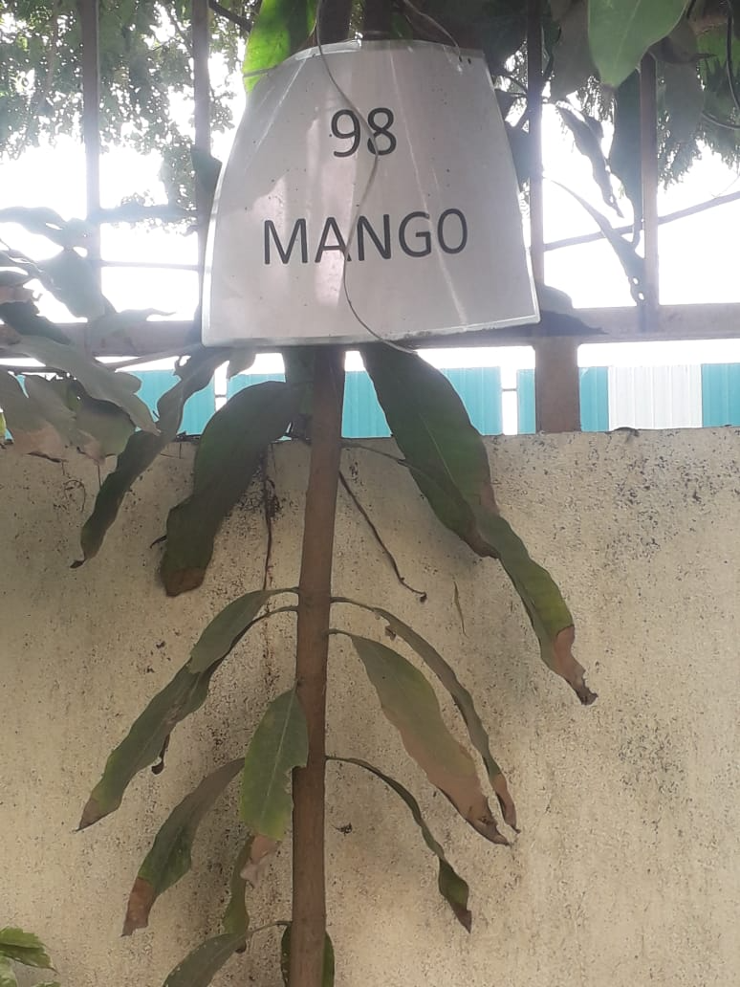
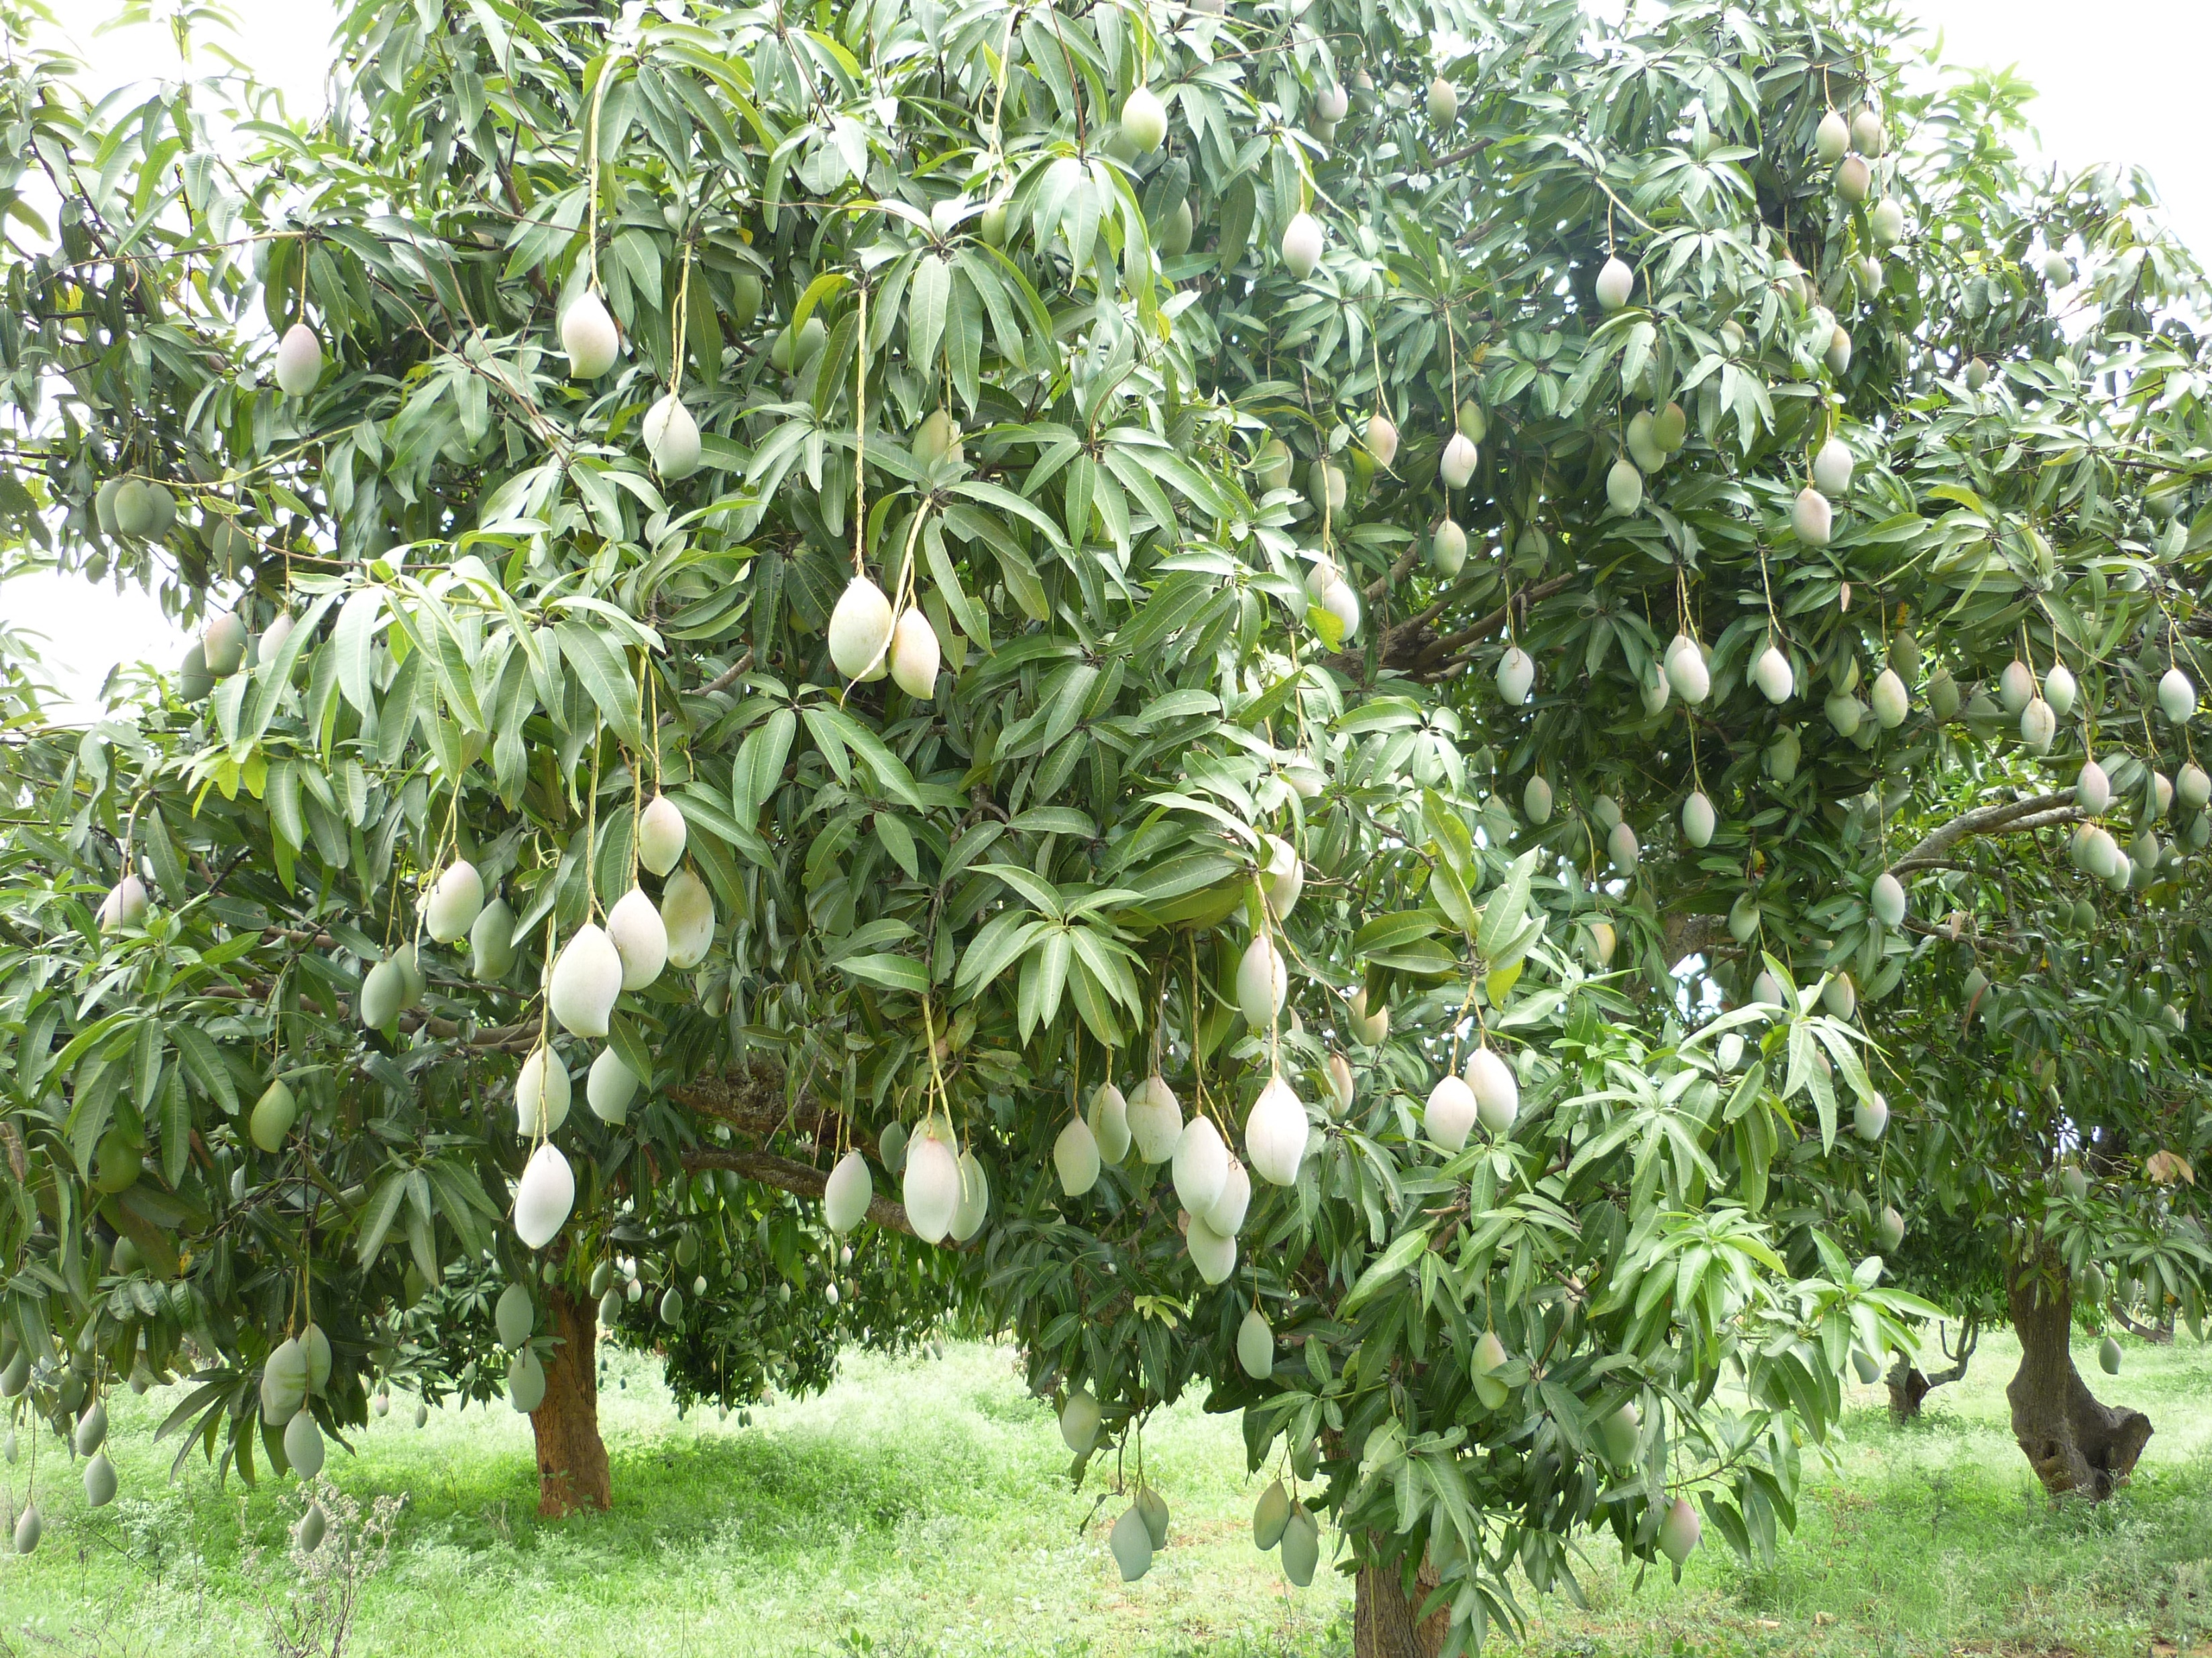
Mango Tree
In front of Reception area AIS Campus, Wakad.

Slide 2
Common name : Mango
Scientific name : Mangifera indica
Family name : Anacardieceae
Habit : Mango trees thrive in warm, tropical climates with
ample sunlight and well-drained soil, requiring
consistent watering and good drainage to produce their
sweet, juicy fruit.
Distribution : Mango is cultivated in South Asia, Southeast Asia, East
and West Africa, the tropical and subtropical Americas,
and the Caribbean.

Slide 3
Description:
Mango trees are deep rooted, symmetrical evergreens that attain heights of 90 feet and widths of 80 feet.
Mango trees have simple alternate lanceolate leaves that are 12 to 16 inches in length and yellow-green, purple, or copper in colour when young.
Mature leaves are leathery, glossy, and deep green in colour.

Slide 4
Uses :
Medicinal: Mango bark has medicinal uses, including treatment for skin
conditions and digestive issues in traditional medicine.
Consumption: The primary use is for its sweet and nutritious mangoes,
consumed fresh, dried, or used in beverages, desserts, and
culinary dishes.
Craft: Mango wood is utilized for furniture, carvings, and construction
due to its durability.
Livestock: Mango seeds can be used in animal feed
Health: Mango seeds can be processed for use in health supplements and
other products.

